Slide 1

Options of Diameter for Plexus
Plexus IPC
02/23/2010
Tony Liu (x5810, zhi_cai.liu@)
12/05/2006

Slide 2
Contents
• Section 1 Overview
• Section 2 Relay
• Section 3 IPDT
• Section 4 GoAhead (GA)

Slide 3
Section 1
Overview

Slide 4
Process deployment (SP)
DS3_HM
SLAM
MGSIG
CCS
OC_HM
GDI
SP_SLAVE
ROUTER
EMF
NI_HM
AUDIO_MGR
SGSIG
BITS_HM
DBP
TL1
…
DIST
…
Master CPU
Slave CPU

Slide 5
Process deployment (CM&CCM)
CPU-D
CCS
SIPA
MEGAA
XU
SIPCL
CPU-C
SIPA
CPU-D
CCS
SIPA
MEGAA
XU
DIST
CPU-C
CPU-B
CCS
ROUTER
SIPA
MEGAA
XU
CPU-B
CPU-A
GDI
CCS
CPU-A
SIPA
MEGAA
XU
CCM
CM

Slide 6
Introduction of Plexus IPC
Relay
  TCP socket
  Shared memory
IPDT
  Shared memory
GoAhead
  Event subscribe/publish

Slide 7
Section 2
Relay

Slide 8
Overview
Used between Trillium stack based processes
  SLAM, DBP, CCS, MEGAA…
Ways of implementation
  TCP socket
  when processes reside on different boards
  Shared memory
  when processes reside on the same board
  more efficient

Slide 9
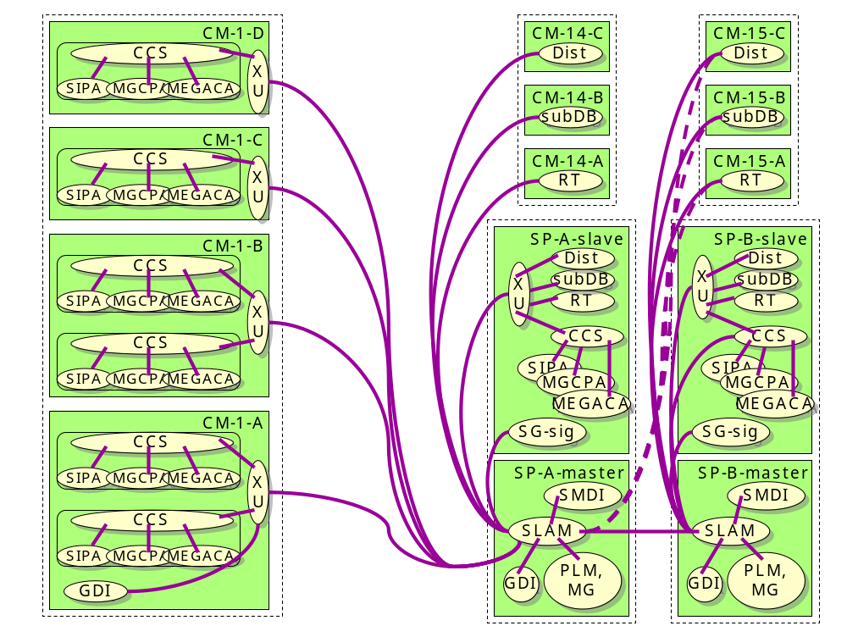
Mesh of relay connections (LGP MGC)

Slide 10
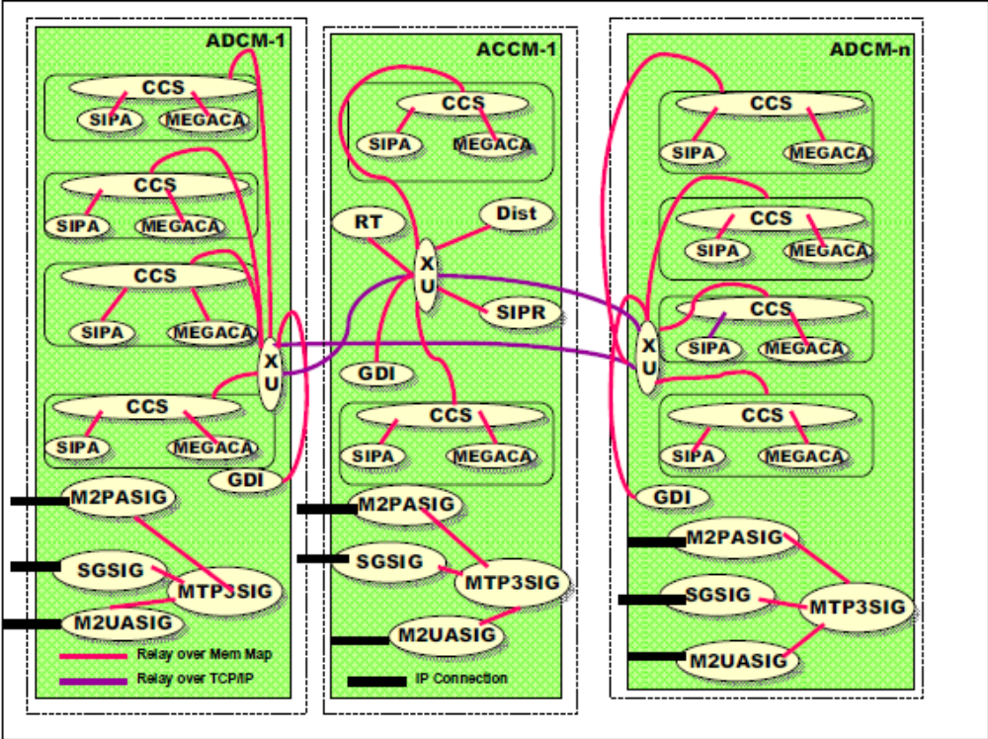
Mesh of relay connections (ATCA)

Slide 11
Introduction of TCP relay
Socket types
  LISTEN
  Listen to incoming connections from other processes
  One socket per process
  CLIENT
  The one initiating the connection
  Will reconnect after the connection is down
  SERVER
  Communicate with client after the connection is up

Slide 12
Deep into TCP relay – connection setup
Configuration
  Configured in ryCfgTCP() in xx_main.c (e.g., sl_main.c for SLAM, ccs_main.c for CCS)
  Key parameters
  IP, port
  Destined process (in format of dstProcId)
  Allowed range of process
  Example
  SLAM(SP master CPU) <-> CCS(SP slave CPU)

Slide 13
Deep into TCP relay – connection setup (cont’d)
Socket setup
  Source file: signaling/relay/ry_tcp.c
  Listen socket: initChanListenTcp()
  Create a socket
  Bind IP and port
  Listen on the socket
  Server socket: initChanServerTcp()
  Create a socket
  Record remote address (of client side)
  Client socket: initChanClientTcp()
  Create a socket
  Bind IP and port
  Open connection to remote side

Slide 14
Deep into TCP relay – sending msg
Upper Layer
Send to TCP
Relay write thread (ryPollWrite)
SPstTsk()
Y
dstProcId == own ProcId?
N
Send to layer’s queue
relay’s txQ
Send via relay
Lower Layer
Append to relay’s txQ

Slide 15
Deep into TCP relay – sending msg (cont’d)
  Common interface: SPstTsk()
  Key parameters
  pst: specify dstProcId, route, etc.
  Relay is used when dstProcId != own ProcId (inter-process data transfer)
  Find appropriate relay channel (by checking allowed process range)
  Relay send interface: ryPstTskTcp()
  pack pst structure and call ryQueTskTcp()
  ryQueTskTcp()
  Enqueue msg to its txQ and send a signal (SIGUSR2) to write thread
  ryPollWrite()
  Traverse each relay’s txQ and send out messages

Slide 16
Deep into TCP relay – receiving msg
Relay
Upper Layer
SPstTsk()
Y
Destined for relay?
N
Unpack pst and message
CLIENT/SERVER
Incoming msg
Connection accepted
LISTEN
Relay read thread (ryIsTskHdlr)
Socket type

Slide 17
Deep into TCP relay – receiving msg (cont’d)
  Key functions:
  Read thread: ryIsTskHdlr()
  Wait for descriptors to be ready and perform data read
  getTskMsgTcp()
  Read data from TCP (recvMsgTcp_blk())
  Segment byte stream into separate messages (recvMsgTcpSeg_blk())
  Post messages to other layers (SPstTsk())
  ryGetTskListenTcp()
  Accept incoming connections
  Look up server channel and record connection info

Slide 18
Introduction of shared memory (MMAP) relay
  Implementation
  Based on POSIX shared memory (memory mapped)
  Use POSIX semaphore to synchronize read and write
  More efficient than TCP
  Only used between processes on the same CPU
  Types
  MASTER
  SLAVE
  There is not much difference between MASTER and SLAVE.
  The main purpose is to divide read and write areas.

Slide 19
Introduction of MMAP relay (cont’d)
MASTER
SLAVE
CCS-DIST
Write area
Read area
CCS-ROUTER
XU-CCS
Read area
Write area
CCS-SIPA
Memory mapped area between 2 processes
…
Memory mapped area of whole system

Slide 20
Deep into MMAP relay - setup
  Definition of memory area division
  Source file: signaling/sigcom/rym_tbl.c
  ryShmTbl_slave[]: for SP slave CPU (LGP platform)
  ryShmTbl_cm[]: for CM (LGP platform)
  ryShmTbl_atca[]: for ACCM/ADCM (ATCA platform)
  Set up memory mapped area
  Call ryShmInit() in ryCfgTCP()
  Open a shared memory object (create it if not exist)
  Set its size to the size specified in ryShmTbl_xxx[]
  Map it to the address space of current process

Slide 21
Deep into MMAP relay – setup (cont’d)
  Set up read/write pointers
  ryInitChanMmap()
  Get offset from the start of the whole mapped memory area
  For MASTER,
  Set write pointer to the start of the offset memory
  Set read pointer to the memory behind write area
  For SLAVE,
  Set read pointer to the start of the offset memory
  Set write pointer to the memory behind read area
  Example
  XU(CM) <-> CCS(CM)

Slide 22
Deep into MMAP relay – sending msg
Notify peer that data is ready
Flush queue
Send to write area
datWPtr
Relay’s txQ
Append to relay’s txQ
Note: no separate thread to flush txQ

Slide 23
Deep into MMAP relay – sending msg (cont’d)
  Relay send interface: ryPstTskMmap()
  Enqueue message
  Flush queue
  Data send: rySendMsgMmap()
  Copy message payload to the write area
  Post semaphore to notify peer that the data is ready

Slide 24
Deep into MMAP relay – receiving msg
  Key functions:
  Read thread: ryMmapTskHdlr()
  Wait on a semaphore for the incoming data
  When signaled, traverse each MMAP relay and read incoming data
  Data read: ryGetTskMmap()
  Read raw data from its read area
  Assemble byte stream into separate messages
  Post it to other layers

Slide 25
Section 3
IPDT
(Inter Process Data Transmission)

Slide 26
Overview
Used in timing-critical tasks (like board failover)
  EMF <-> XX_HM(DS3_HM, OC_HM, …)
Implementation
  Based on shared memory
  Controlled in kernel
  Mapped in user space
  Use semaphore to synchronize

Slide 27
Deep into IPDT- setup
Initialization in kernel
  Source file:
  lynx/sys/drivers.voip/ipdt/ipdt_share_mgr.c
  Key functions:
  ipdt_install()
  Allocate physical memory
  Arrange memory by calling ipdt_init_share()
  ipdt_init_share()
  Segment memory into queues with different size

Slide 28
Deep into IPDT- setup (cont’d)
free_buf_q buf ptrs
Header
free_buf_q
IPDTQInfoTable[]
Queue Entry Pointers
512_buf_q
…
1024_buf_q
512_buf_q buf ptrs
…
Queue Headers
…
16KB
Buffers
16KB
8KB
4KB
2KB
1KB
512B
16KB
2KB
…
2KB
512B
…
8KB
512B
8KB
…
…

Slide 29
Deep into IPDT- setup (cont’d)
Initialization in user space
  Source file:
  telica_common/src/setup_shared_mem.c
  Key functions:
  ipdt_setup_shared_mem()
  Open /dev/ipdt and get memory info
  Open /dev/mem and mmap physical address into user space

Slide 30
Deep into IPDT- sending msg
Example (ANA failover)
EMF -> OC_HM
  Function: NotifyIomFailover()
  source file: ga_dev/solution/eqm/src/eqmshm.c
  Process:
  Get buffer: ipdt_get_rbuf()
  Copy data: ipdt_copydata()
  Send buffer: ipdt_send_rbuf()
  Signal the semaphore to notify OC_HM

Slide 31
Deep into IPDT- sending msg (cont’d)
Get a free buffer
  User space interface: ipdt_get_rbuf()
  Get a free buffer from free_buf_q by calling ioctl()
  Kernel implementation: ipdt_dqb()
  Remove an entry (at DQIdx) from specified queue
Queue Header
Queue Entry Pointers
…
PtrX
buf
NQIdx
…
DQIdx
Queue Content
PtrY
…

Slide 32
Deep into IPDT- sending msg (cont’d)
Copy data
  ipdt_copydata()
Send buffer
  User space interface: ipdt_send_rbuf()
  Send buffer to specified queue by calling ioctl
  Kernel implementation: ipdt_nqb()
  Assign an entry (at NQIdx) from specified queue to point to this buffer

Slide 33
Deep into IPDT- receiving msg
Example (ANA failover)
EMF -> OC_HM
  Function: HandleIomFailover()
  source file: oc_hm/src/ocMain.c
  Process:
  Wait on a semaphore for incoming data
  Get data-holding buffer: ipdt_recv_rbuf()
  Operate on the data
  Return buffer to queue: ipdt_free_rbuf()

Slide 34
Section 4
GoAhead (GA)

Slide 35
Overview
Introduction
A development framework that provides platform support
In-memory database built around databases, tables, columns, rows
Reading database information from and persisting it to XML files
Solution pack loading and initializing
IPC (Event subscribe/publish)
Hashtables
IPC
TCP socket based
Event abstraction (hashtable)
Between processes containing GA endpoint (EMF, SLAM, XX_HM…)

Slide 36
GA IPC schematic
GA Endpt
SLAM
GA Endpt
GA Endpt
EMF
XX_HM
GA Endpt
TL1

Slide 37
Deep into GA IPC – setup
EMF acts as SERVER
  Key function: hapiOpenListener()
Open a listen socket and listen on port 1199
Register callback functions to initialize when a new connection is accepted
Other processes (SLAM, XX_HM) act as CLIENT
  Key function: InitApp()
Initialize process with command-line arguments
Establish connection with EMF
Example
Run “netstat –anp | grep 1199” on a lab and see the result

Slide 38
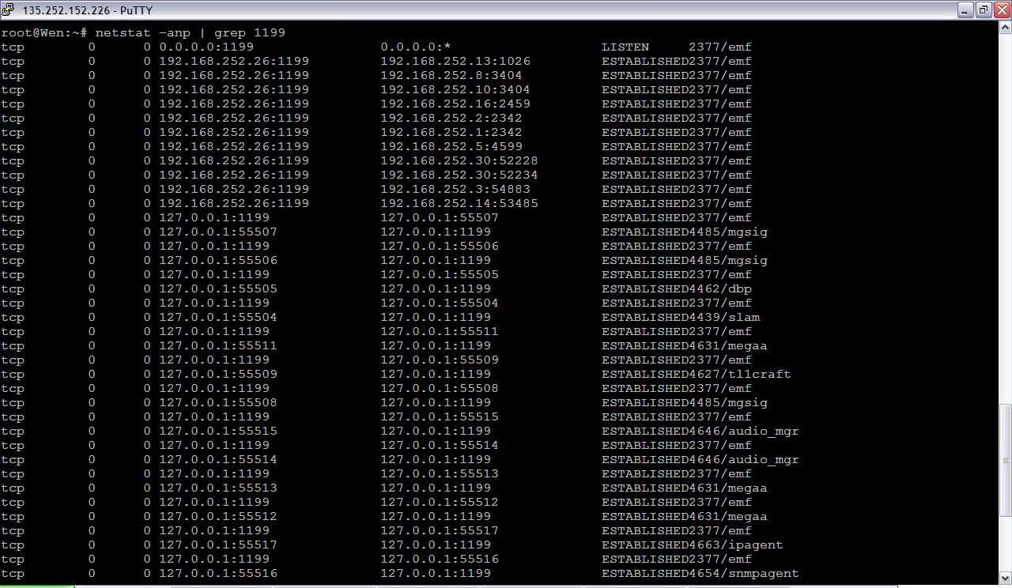
Deep into GA IPC – setup (cont’d)

Slide 39
Deep into GA IPC – event handling
Subscribe
  Each process can register a callback function for interested event
  Function: hapiSubscribe()/SubscribeEvent()
Add a new entry to its callback list (hash table)
Publish
  Process can publish event & data to wanted end point
  Function: hapiPublish()/PublishEvent()
Send request via TCP, first header (including event, data length, etc), then data

Slide 40
Deep into GA IPC – event handling (cont’d)
Receive side
  Function: hapiReadHandler()
Read header from TCP, get data length
Read raw data
Parse each field (event/class/source…)
Process message with registered callback (Look up in its callback list)

Slide 41
The End

